Slide 1
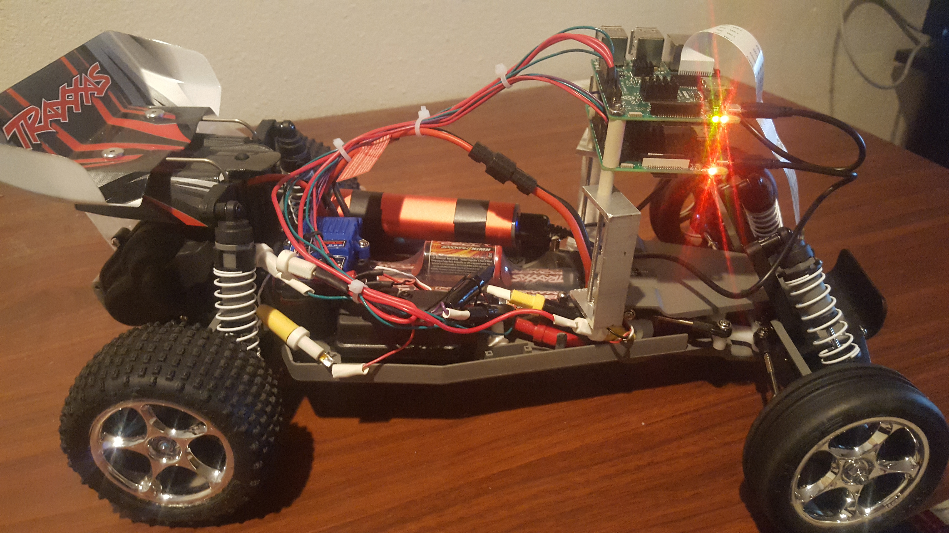

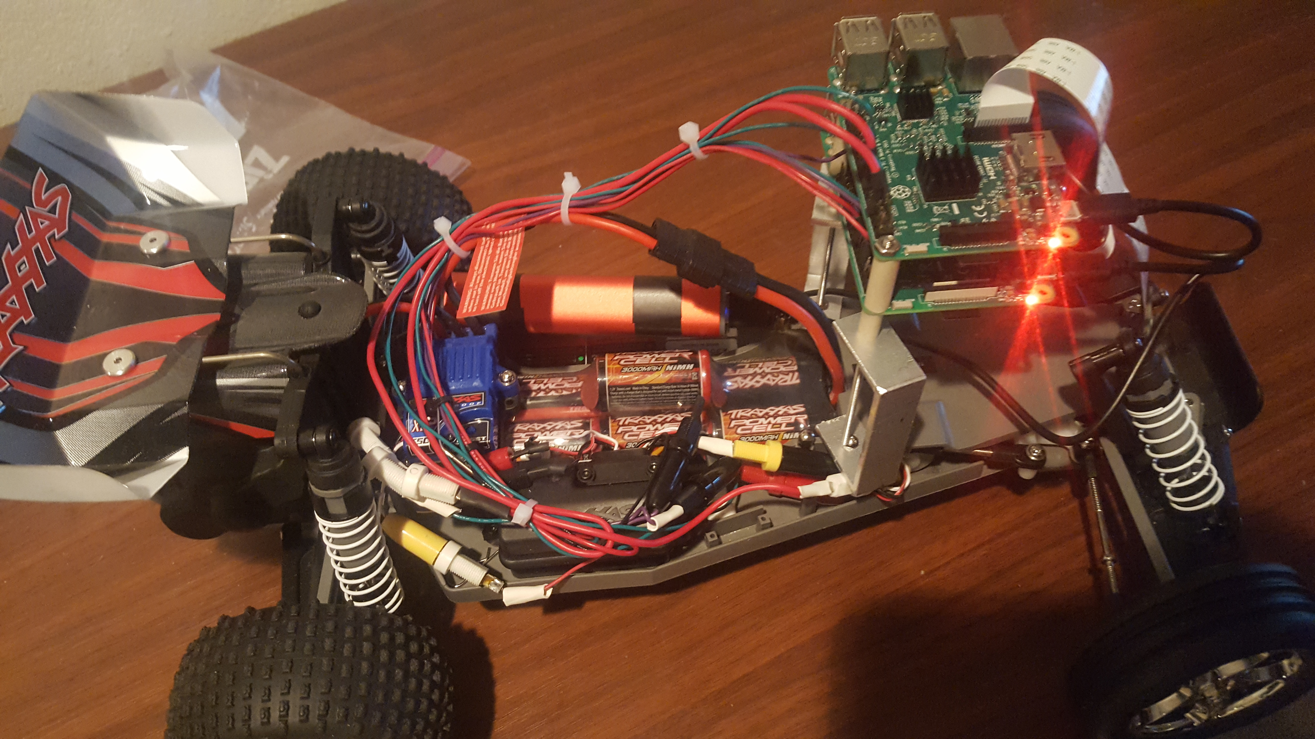
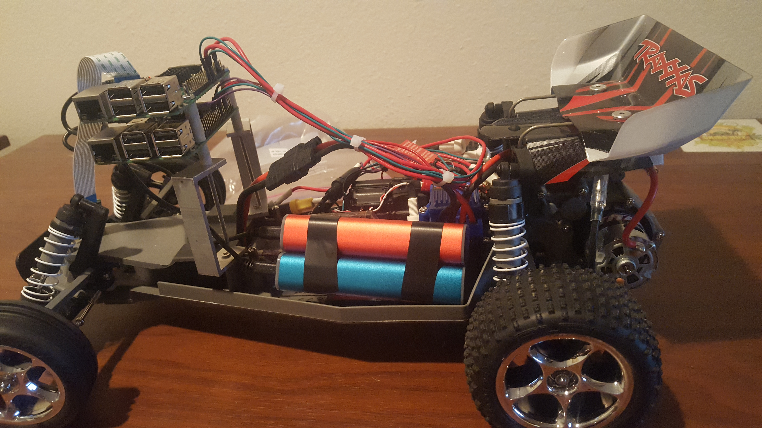
Android App Controlled RC Car
Eric Junkins
Joe Wroe
Jean-Christophe Owens
Vilok Krishnan

Slide 2




Development Tools Used
Trello
Project Tracking
Github
Version Control
Android Studio
Android IDE
Raspberry Pi 3
Hardware communcation

Slide 3
Overview
Battery pack
Drive Shaft
Speed Controller
Steering Servo
Steering Axel
Receiver
Controller

Slide 4

Overview
Battery pack
Drive Shaft
Speed Controller
Steering Servo
Steering Axel
Controller

Slide 5
Design Aspects
Reverse Engineer receiver signals (no documentation ☹)
Replace receiver with Raspberry Pi to mimic signals
Write Android App to control Raspberry Pi over remote signal

Slide 6
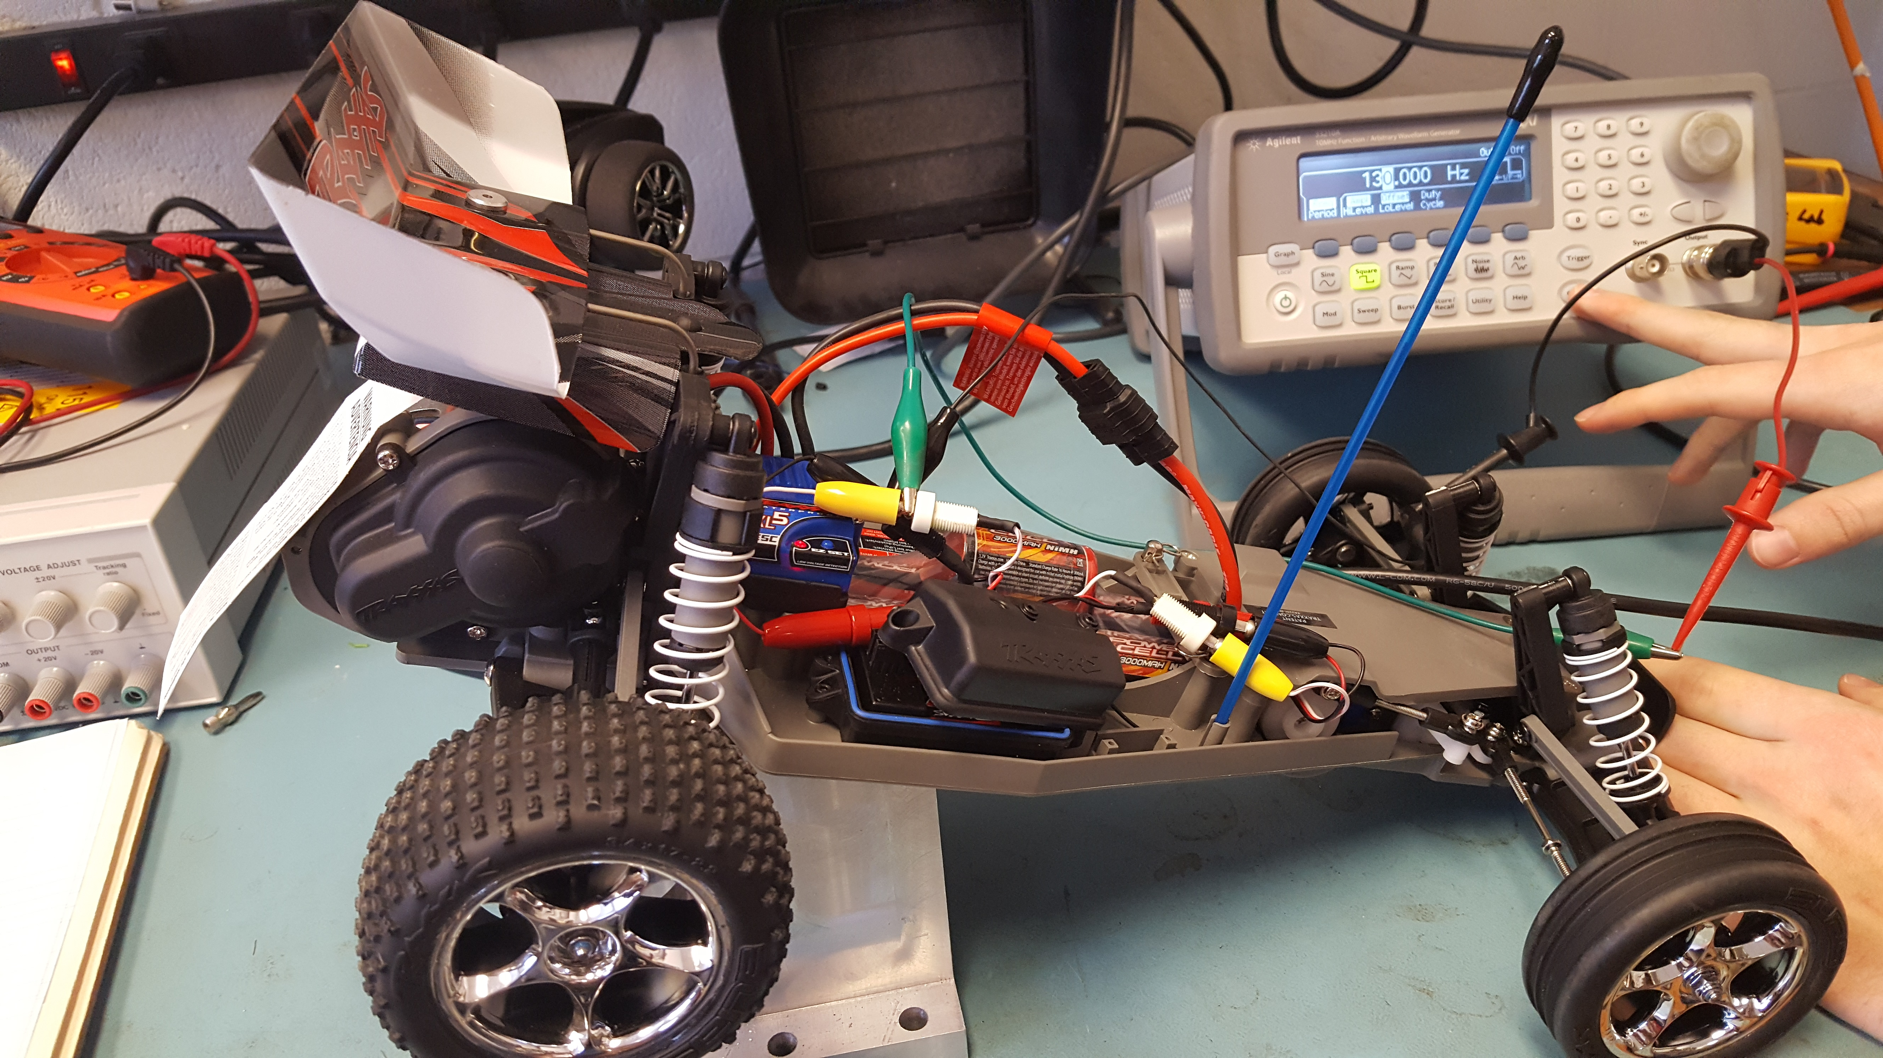
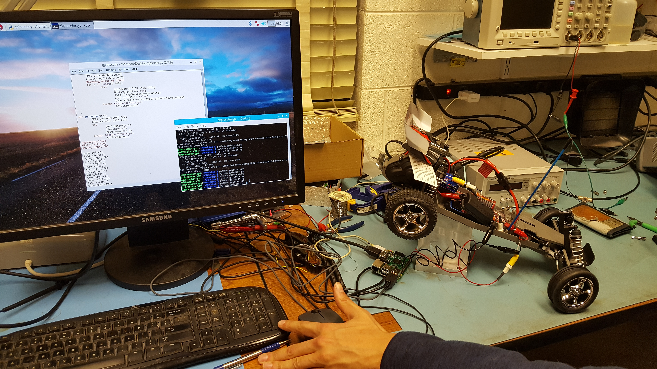
Reverse Engineer Signals

Slide 7
Signals
10ms
1.5ms
Periodic at 10ms
3.3V Digital
Base signal at 1.5ms (do nothing)
Identical signals to both systems
Turn left or throttle backward (max)
Turn right or throttle forward (max)
3.3V
1.0ms
2.0ms

Slide 8
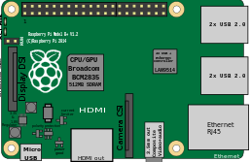
Physical System
Battery pack
Drive Shaft
Speed Controller
Steering Servo
Steering Axel
PiCam
Android App
Rtsp web address

Slide 9


Raspberry Pi Signals
Use the GPIO pins to output square pulse based on input from App
2 Separate Pis, one for each mechanical system on car
Master Pi – communicate to/from App
Slave Pi – takes commands from Master Pi
Master Pai Mei
-Kill Bill (2003)

Slide 10
Networking Signals
Use WIFI sockets to communicate
~72MBPS (necessary for video)
Mastery Pi config change to broadcast WIFI
App/Slave Pi will connect to network
Send PiCam stream to rtsp web address:
rtsp://192.168.1.80:8554/myPicam/Stream.mp4

Slide 11
A Few Other Things To Do
Init Scripts on Main Pi:
Start pigpiod daemon
Start python script listening for socket connection to Slave Pi and App
Init Script on Slave Pi:
Start pigpiod daemon
Initialize python script with wifi socket to Master Pi
Haptic Feedback on App
Joysticks
Video player
Speedometer on App

Slide 12
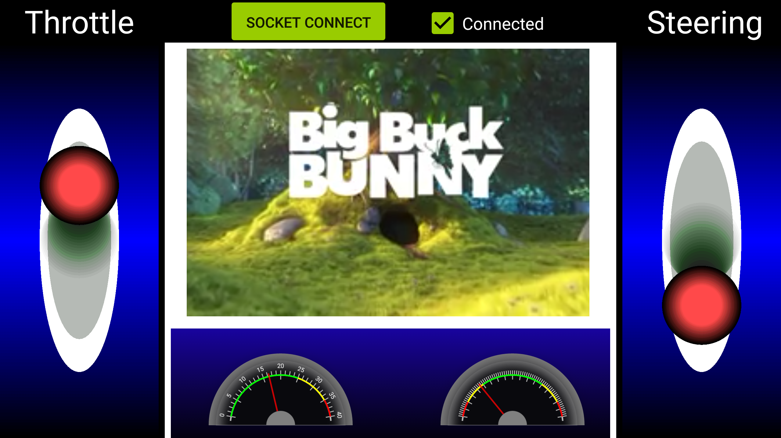
Android App
Connects to Wifi Socket on RPi
Status of Wifi Socket
Video Player
Throttle Joystick
Steering Joystick
Throttle Speedometer
Steering Speedometer

Slide 13
Other Features/Future Implementations
Get PiCam Stream to work
Joystick override with accelerometers in phone mode
Simple voice command (Snowboy Hotword Detection)
Locally run, no internet server
Trainable

Slide 14
Demo

